Slide 1
Gale Presents: Miss Humblebee’s Academy

Slide 2
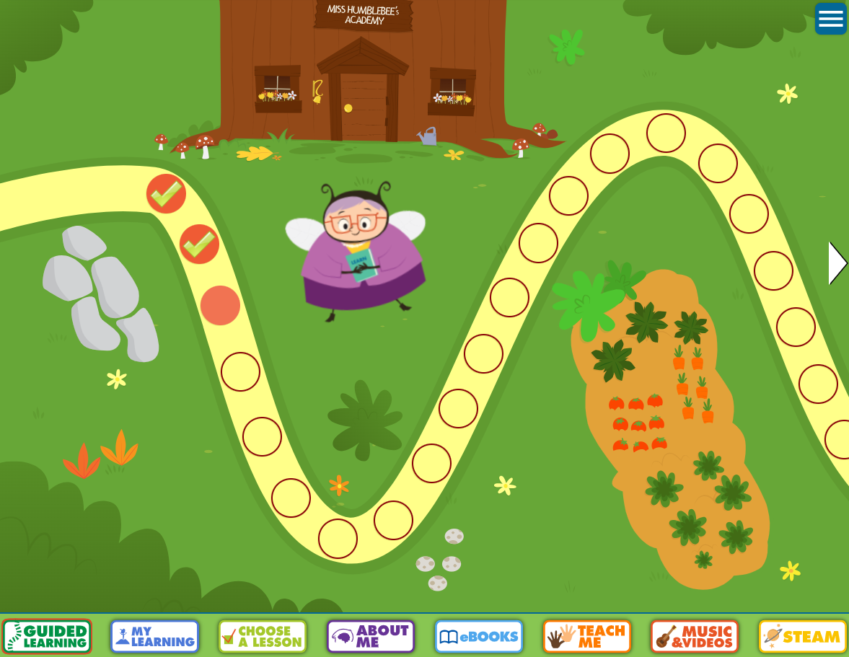
GALE PRESENTS: MISS HUMBLEBEE’S ACADEMY
SUPPORT KINDERGARTEN READINESS
Content designed for children ages 3-6 aligned to preschool and elementary standards.
CROSS-CURRICULAR SUPPORT
Subjects include Language and Literacy, Math, Social Studies, Science, Art, Music, SEL, and Health.
GUIDED AND CUSTOMIZABLE LEARNING PATHWAY
Pre-designed pathway to lead children through learning, as well as the ability to self-explore and select different lessons.

Slide 3
ACCESSING THE RESOURCE

Slide 4
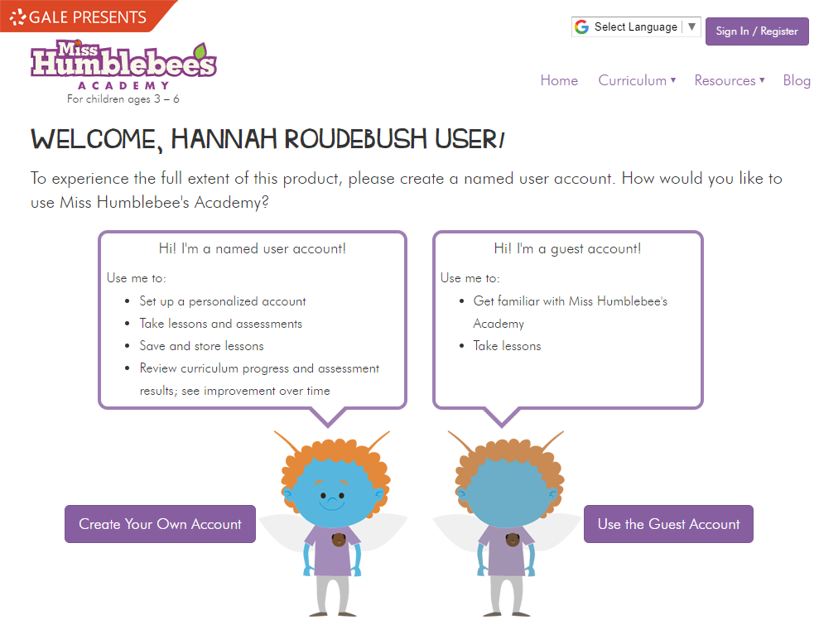
CREATING AN ACCOUNT OR LOGGING IN
Sign In to a preexisting account
First time users can Create an Account here. This allows users to:
set up and customize an account.
add multiple learners.
take and save lessons and assessments.
review progress.
earn rewards.
Access content as a Guest. You can take lessons and explore the content, but progress will not be saved, and rewards will not be earned.

Slide 5
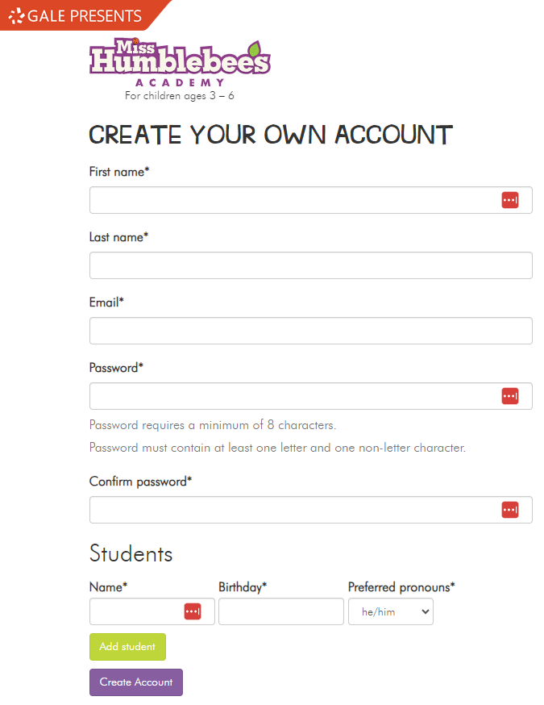
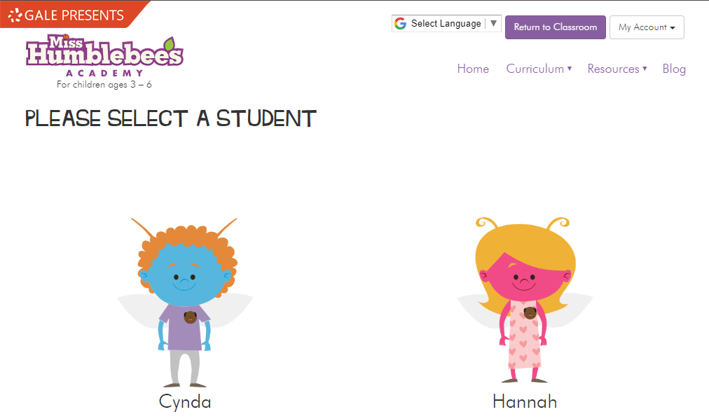
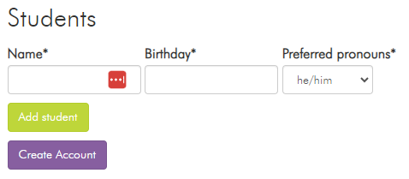
CREATING AN ACCOUNT
To create an account in Miss Humblebee’s Academy, enter your name, an active email, and create a password.
This is also where you can add multiple students so you can track their progress on one adult account.

Slide 6
NAVIGATION AND DISCOVERY
Notes:
This section walks through how to utilize the platform to find content.

Slide 7
SIMPLE ACCESS TO ALL SUBJECTS AND LESSONS

Slide 8
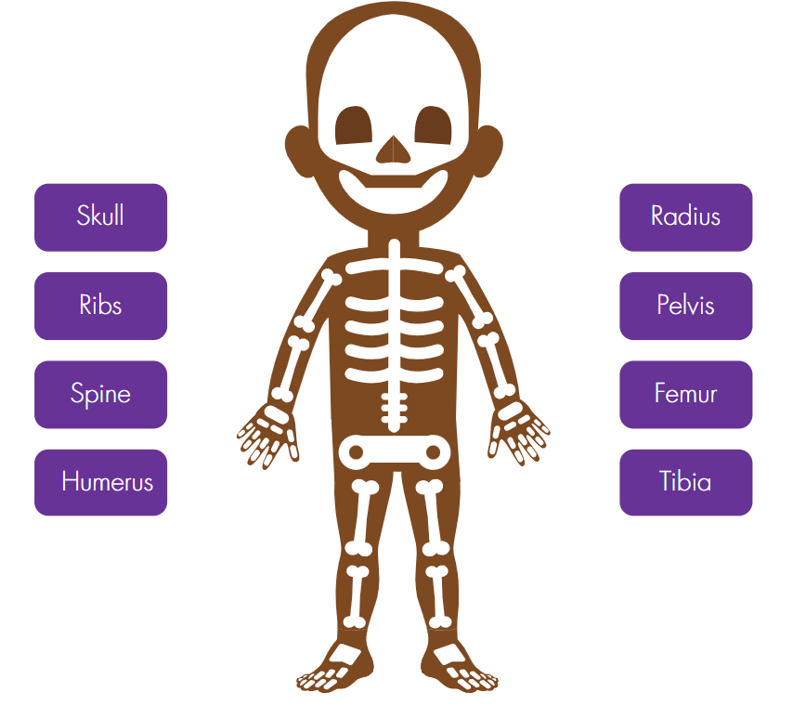
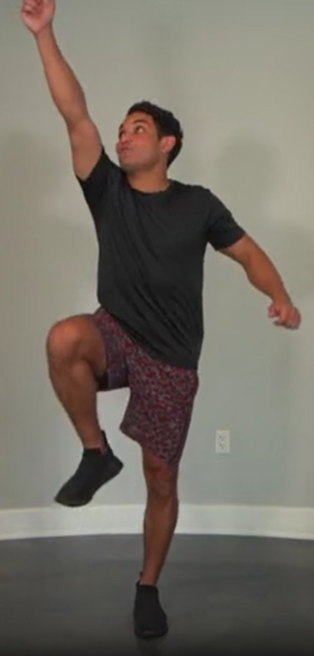
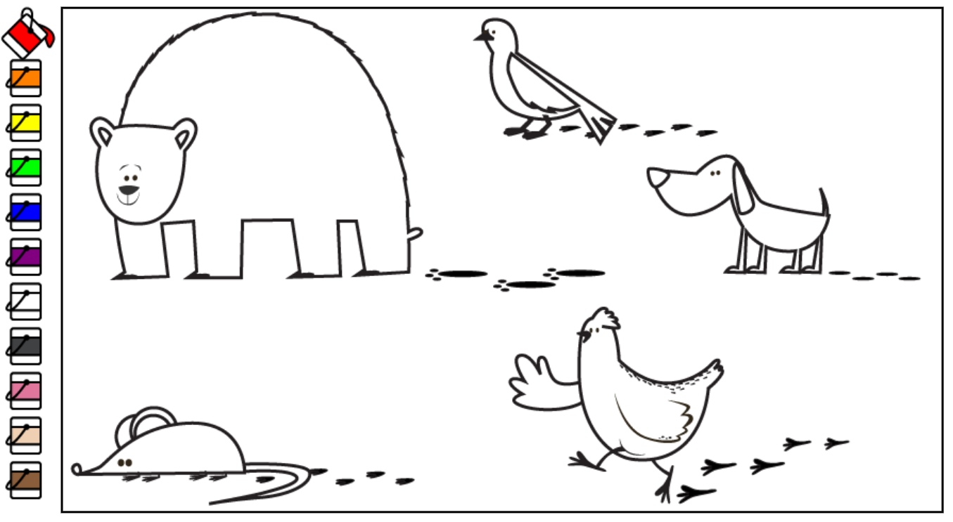
Guided Learning lessons take students through a variety of activities in every subject area.
This includes:
cross-curricular, instructor-led videos.
instructional music videos.
eBooks.
Matching, coloring, and reading activities.
and more!

Slide 9
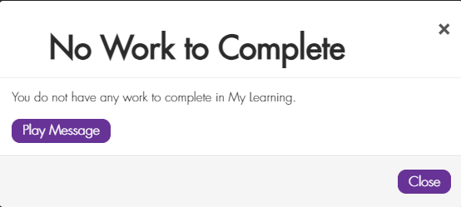
My Learning is a learning path that can be customized on the adult account.
If there is no learning assigned, learners will receive a No Work to Complete notification.

Slide 10
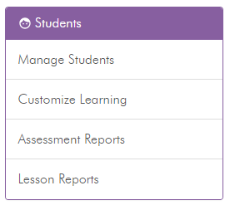
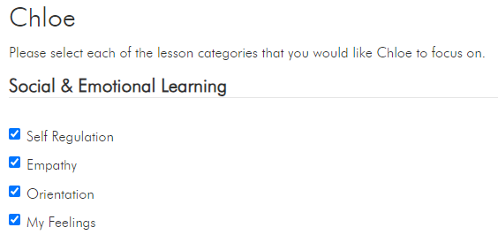
Adults can customize the My Learning section for their learner.
Under the Students section of the Dashboard page, select Customize Learning. If you have multiple learners on your account, select the learner which you wish to customize learning for.
You can then select learning focuses under the categories of:
Social & Emotional Learning
Language & Literacy
Art
Music
Math
Science & Social Studies
Bee Fit

Slide 11
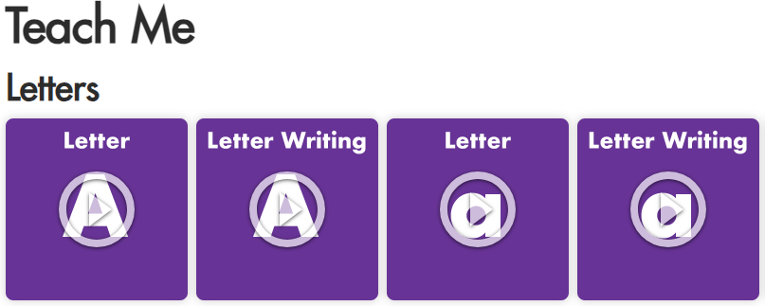
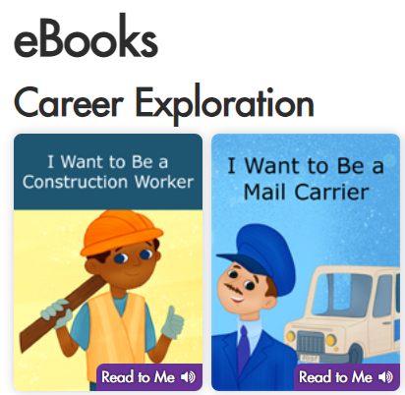
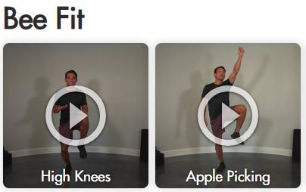
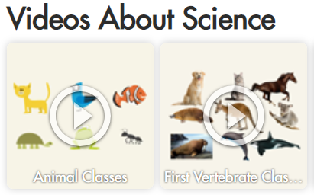
The Choose a Lesson category opens a menu of all content within Miss Humblebee’s Academy.
This includes:
eBooks.
Instructor-Led Videos.
Music and Learning Videos.
STEAM Activities.
Printables.

Slide 12
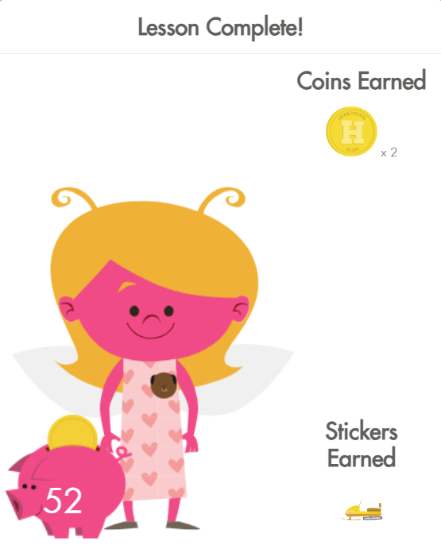
Students earn rewards, such as coins, stickers, and puzzle pieces, for completing activities.
They can use these in the About Me Section to customize their own avatar and complete puzzles.

Slide 13
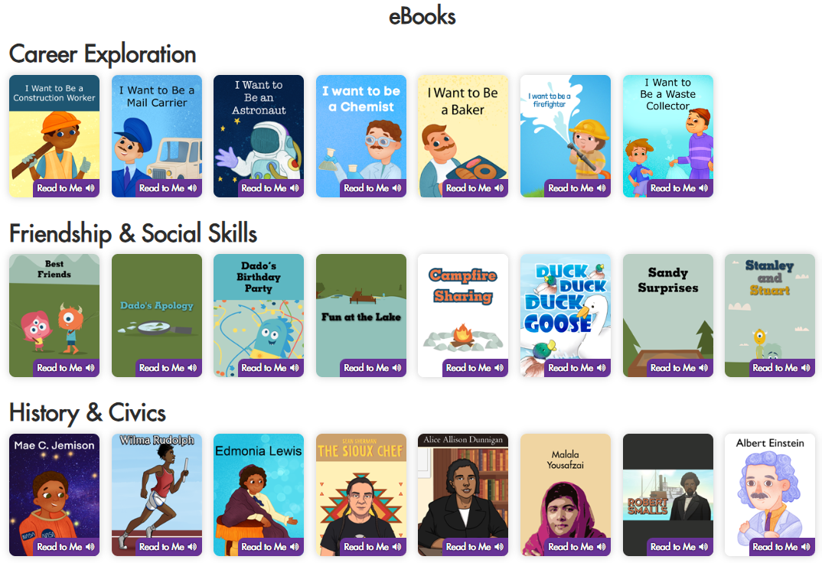
The eBooks section will open every eBook available in Miss Humblebee’s Academy.
eBooks are organized into bookshelves by topic area. Topic areas include:
Career Exploration
Friendship and Social Skills
History and Civics
Life Science
My & My Family
Special Interest

Slide 14
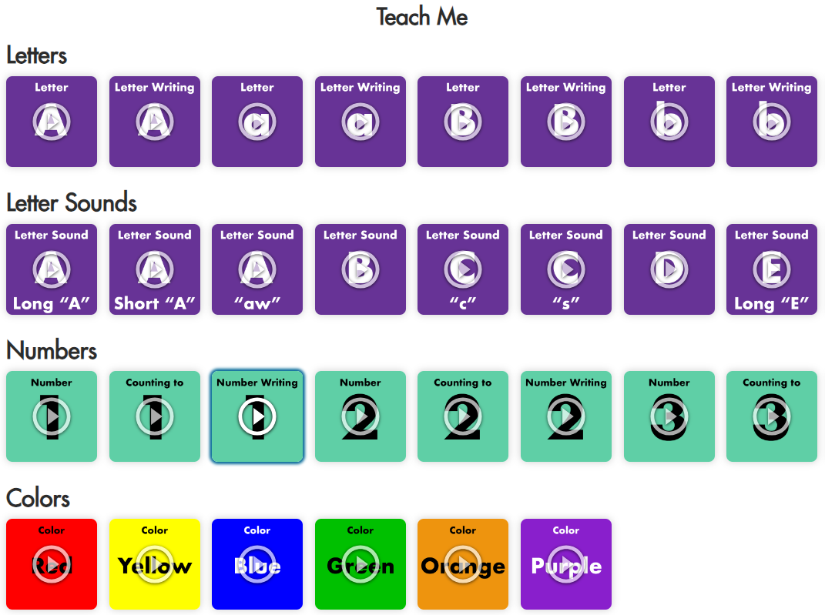
The Teach Me section will open every instructor-led video available in Miss Humblebee’s Academy.
Videos are organized by topic area. Topic areas include:
Letters and Letter Sounds
Numbers
Colors
Shapes
Science
SEL
Bee Fit

Slide 15
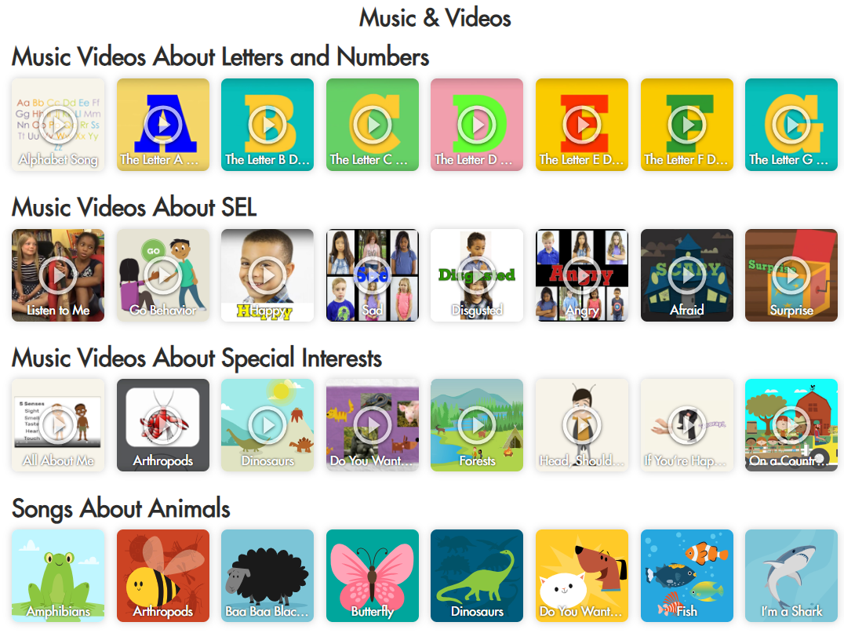
The Music & Videos section will open every video available in Miss Humblebee’s Academy.
Videos are organized by topic areas.

Slide 16
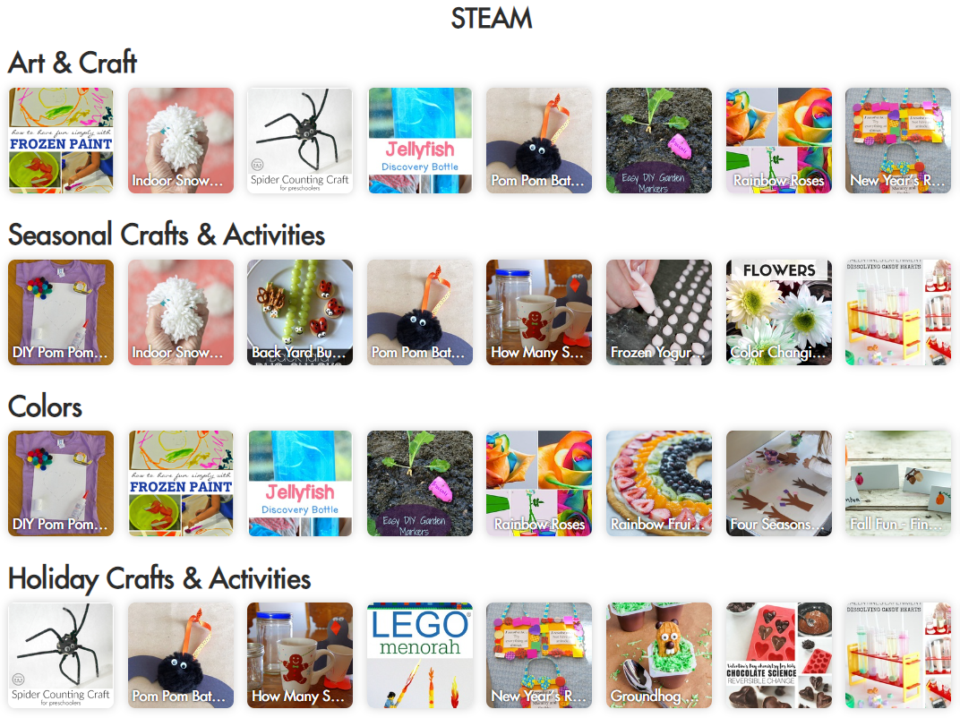
The STEAM (science, technology, engineering, art, and math) section houses all the offline and printable activities available in Miss Humblebee’s Academy.
Activities are organized by topic area.
These make great activities for at home, in the classroom, or in library programming.

Slide 17
THE DASHBOARD
Notes:
This section walks through how to utilize the platform to find content.

Slide 18
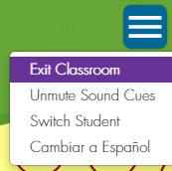
ACCESSING THE DASHBOARD
To return to the Dashboard, select Exit Classroom.

Slide 19
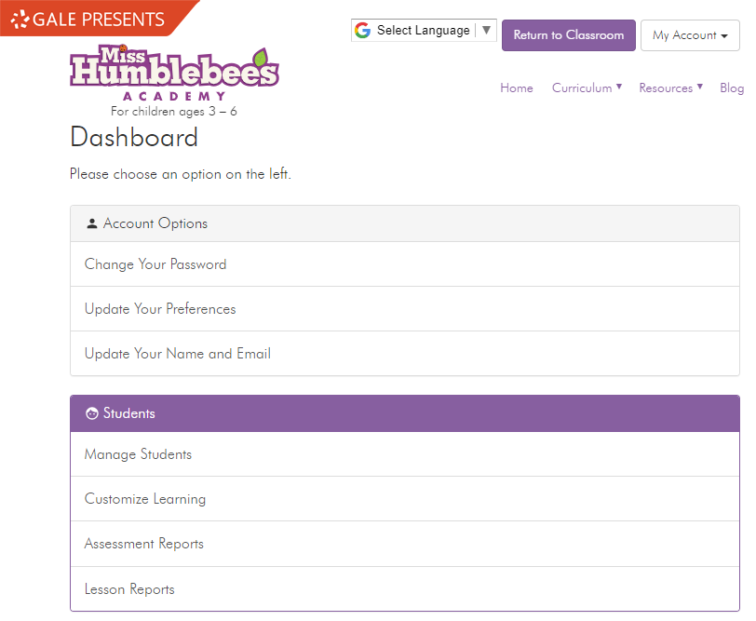
USING THE DASHBOARD
The Dashboard is where adults can adjust their account settings, customize learning, and access printable materials.
In the Students section, adults can manage students, customize learning, and view assessment & lesson reports.

Slide 20
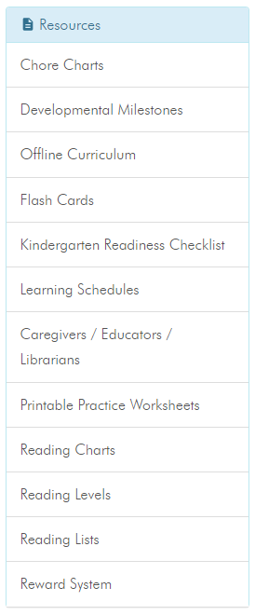
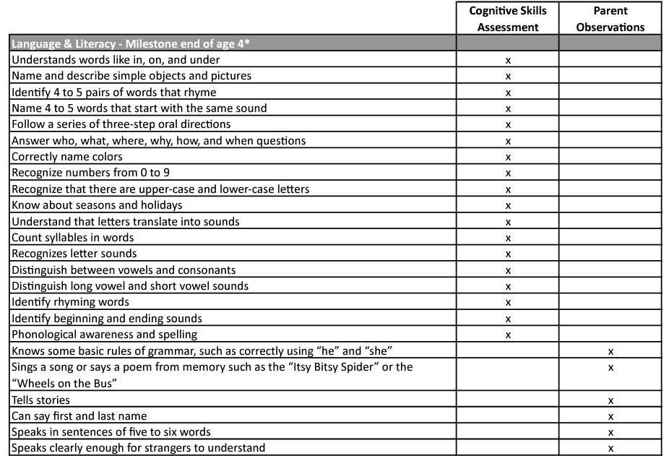
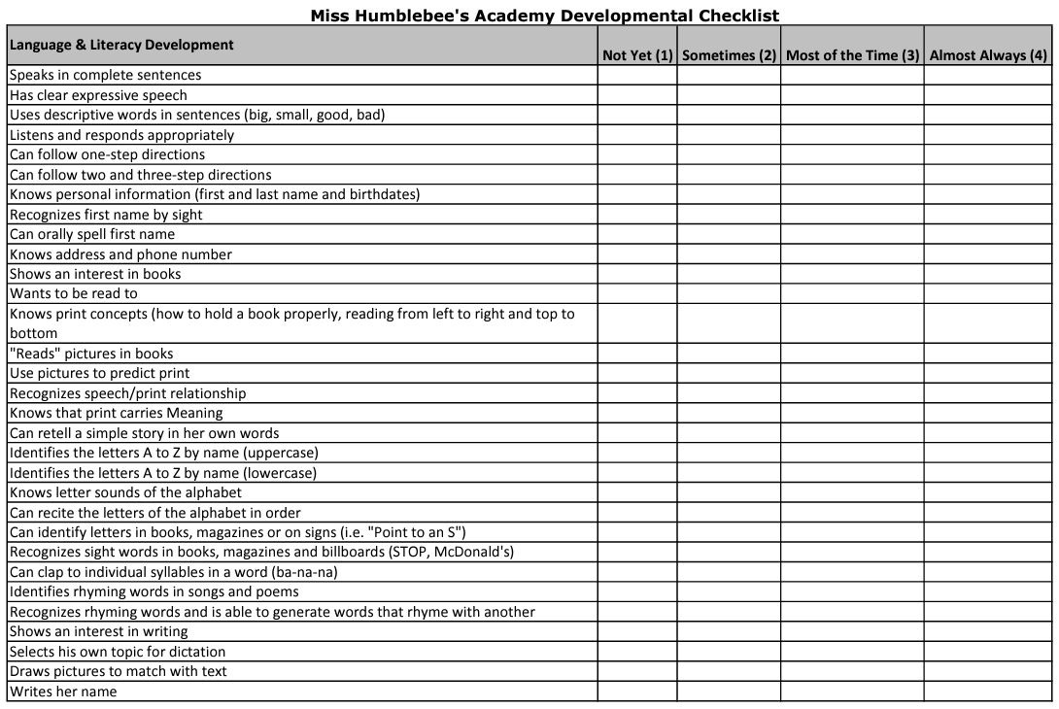
PRINTABLE RESOURCES
The Resources section of the Dashboard has printable documents for adult use and reference.
These include:
Developmental Milestones
Kindergarten Readiness Checklist
Learning Schedules
Reading Charts, Levels, and Lists
A Reward System
Chore Charts
Monthly Planner
And more!

Slide 21
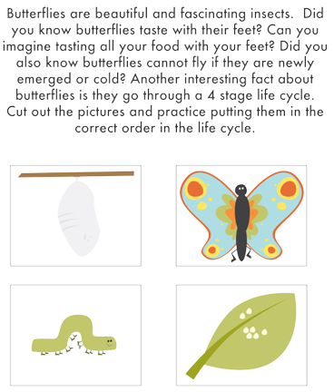
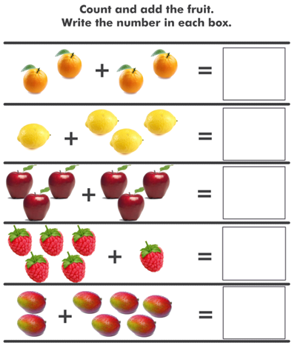
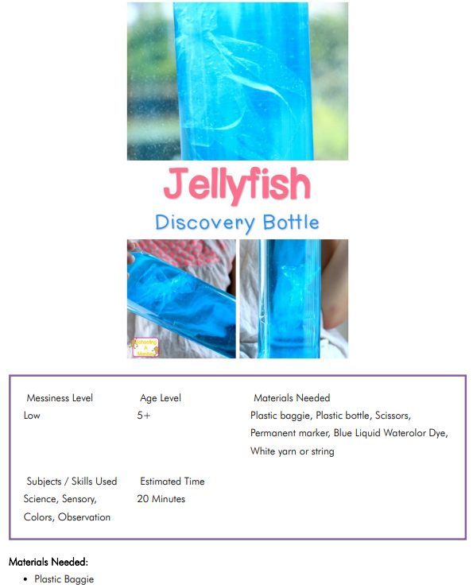
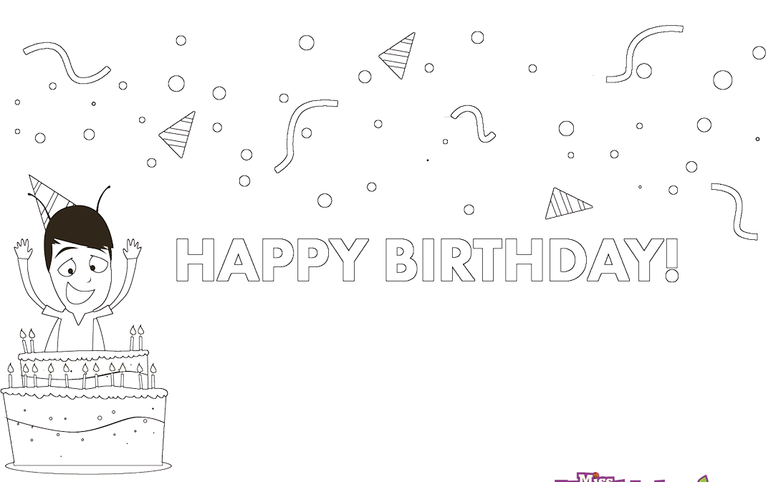
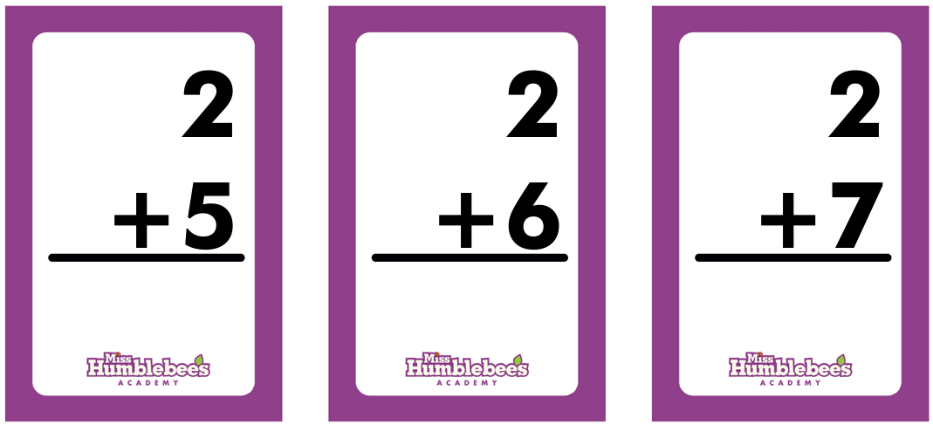
PRINTABLE RESOURCES
The Resources section of the Dashboard also has many printable activities that can be used with learners.
These include:
STEAM Activities
Flash Cards
Practice worksheets in math, science & social studies, letters, and numbers.
Coloring Pages
Word Building
And more!

Slide 22
?
…
Notes:
Use this slide as a visual prompt for final questions and/or discussions. If you have the time, try to access Gale Presents: Udemy and provide a walkthrough before questions.

